Slide 1
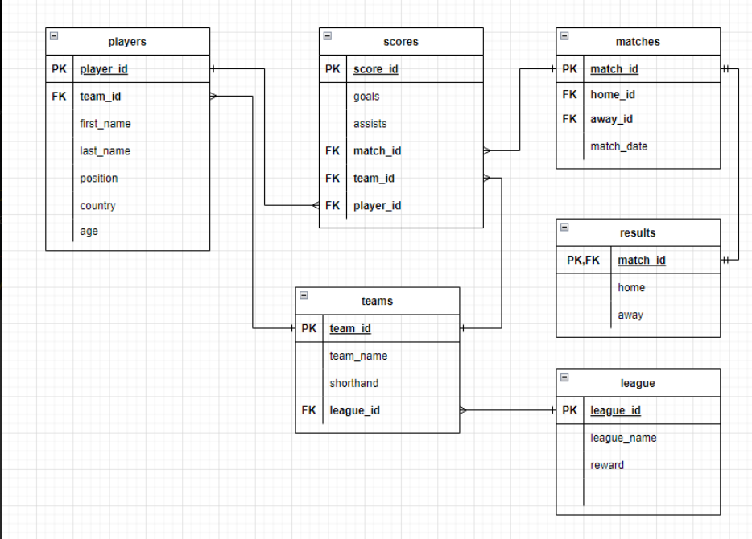

Slide 2

Viewler

Slide 3
show_fikstür
Create view show_fikstür as SELECT t1.team_name as home_name,t2.team_name as away_name,`match_date`,results.home as home_skor, results.away as away_skor FROM matches JOIN teams AS t1 ON home_id= t1.team_id JOIN teams AS t2 on away_id= t2.team_id LEFT JOIN results on matches.match_id=results.match_id

Slide 4
Player_informations
CREATE VIEW player_informations AS
SELECT teams.team_name, first_name, last_name, age, position, country,COALESCE(SUM(scores.goals),0) as goal ,COALESCE(SUM(scores.assists),0) as asist
FROM players
LEFT JOIN teams ON players.team_id = teams.team_id
LEFT JOIN scores on players.player_id = scores.player_id
GROUP BY (players.player_id)

Slide 5
Trigger

Slide 6
Update_result
DELIMITER $$
CREATE TRIGGER update_result
AFTER INSERT ON scores
FOR EACH ROW
BEGIN
UPDATE results
LEFT JOIN scores ON NEW.match_id=results.match_id
LEFT JOIN matches ON matches.match_id=results.match_id
SET home=if(NEW.team_id = matches.home_id,(SELECT home from results WHERE results.match_id = NEW.match_id)+NEW.goals,home),
away=if(NEW.team_id = matches.away_id,(SELECT away from results WHERE results.match_id = NEW.match_id)+NEW.goals,away)
WHERE results.match_id = NEW.match_id;
END$$
DELIMITER ;

Slide 7
Add_result
CREATE TRIGGER add_result
AFTER INSERT ON matches
FOR EACH ROW
INSERT INTO `results`(`match_id`, `home`, `away`) VALUES (NEW.match_id,0,0);

Slide 8
Stored procedures

Slide 9
show_home_name
DELIMITER &&
CREATE PROCEDURE show_home_name (IN var1 varchar(50))
BEGIN
SELECT * FROM `show_fikstür` WHERE home_name=var1 or away_name=var1;
END &&
DELIMITER ;
SET @name = varchardeğeri;
CALL show_home_name(@name);
SELECT @name;

Slide 10
Functions

Slide 11
CONCAT
SELECT matches.match_id, CONCAT(t1.team_name," vs ", t2.team_name) AS Maç FROM matches JOIN teams as t1 on t1.team_id=matches.home_id JOIN teams as t2 on t2.team_id=matches.away_id

Slide 12

Sayfalar

Slide 13
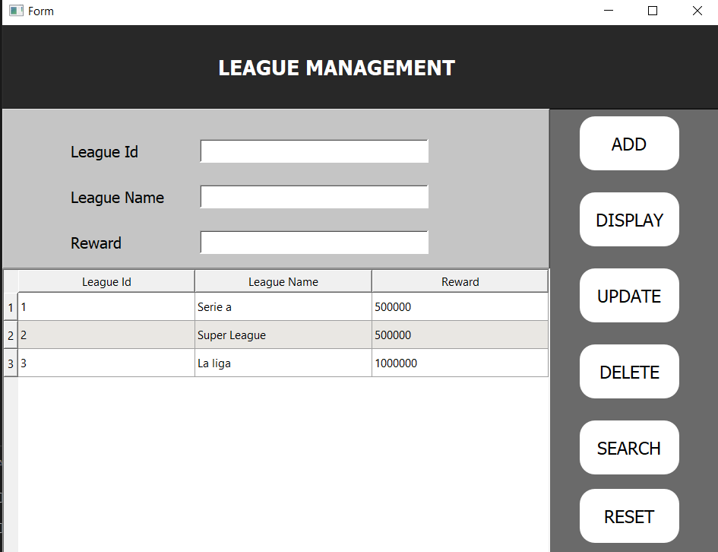
Lig tablosu

Slide 14
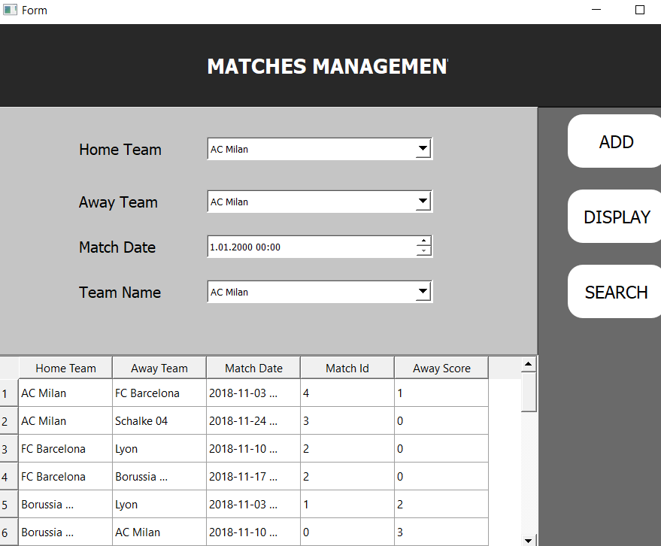
Fikstür tablosu

Slide 15
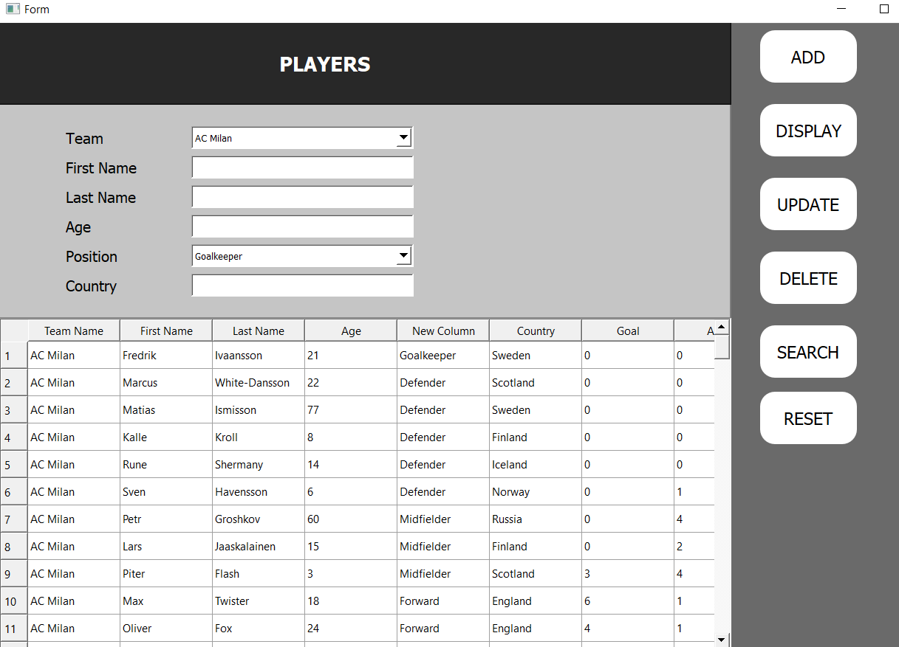
Oyuncular tablosu

Slide 16
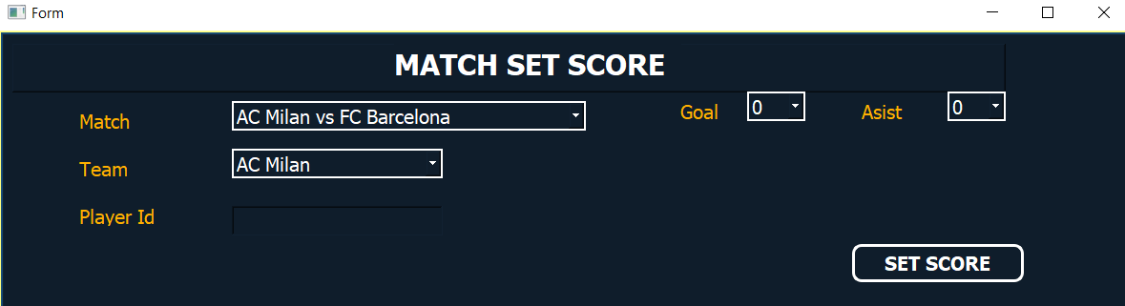
Skor ekleme tablosu

Slide 17
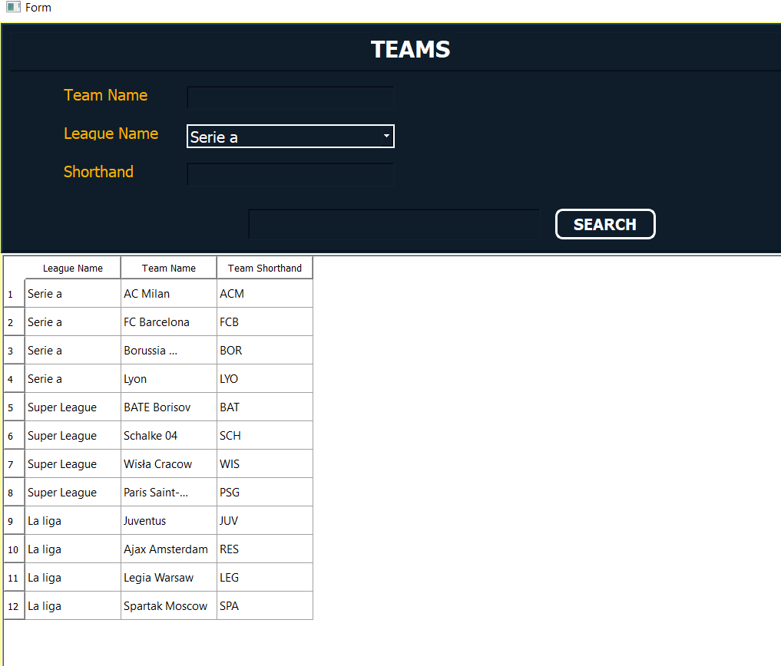
Takımları görüntüleme tablosu

